Slide 1
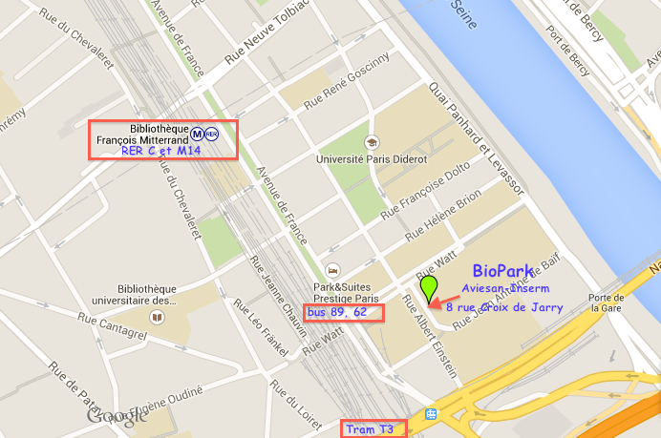
AUDITORIUM
11 rue Watt
Hotel Park&Suites

